Slide 1
Debugging

Slide 2
Announcements
Opening Question
How do you usually study for an exam?
Practical 1 - work on it right away!
Only three files have errors (rest are read only)
Debugging is hard!
Especially if you wait until all the code is written…
This week:
Monday Lecture – help on debugging / coding follow along
Coding exam – Tuesday in Lab
Wednesday Lecture - review session (Need questions!)
Canvas exam – Thursday in Lab
Friday Lecture – Cancelled (take time to catch up)
ACM-W Diversity in Computing Dinner
When: Thursday September 16th at 5:30pm
Where: LSC room 382
RSVP: https://forms.gle/LdDiVAPaui5Ctgw38
ACM Advice From the Career Center
When: Wednesday, September 15 at 6:00pm
Where: Computer Science Building room 130
RSVP: https://forms.gle/tqHqxZFTRf2CKBX59

Slide 3
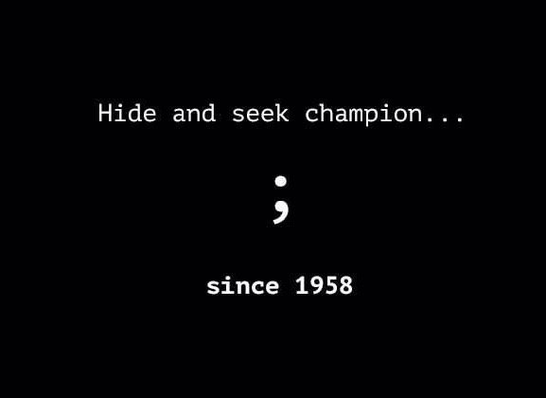
Debugging Code
Code in zybooks – to follow along with!
Compile Errors
bad syntax
missing semicolon (bane of all coders)
missing curly brackets
Runtime Errors
Crashes while running
Logic Errors
Poor logic
Works, but not as intended
Solution
code only a few lines at a time
run after a few lines
even if running doesn’t do much!
Methods help you group code
Debug and test methods as you write
Let’s look at some examples

